Slide 2
Webinar #4 –
Pre-Show Details
Hosted by: Kelsey Kwasniak and Kendall Reynolds

Slide 3
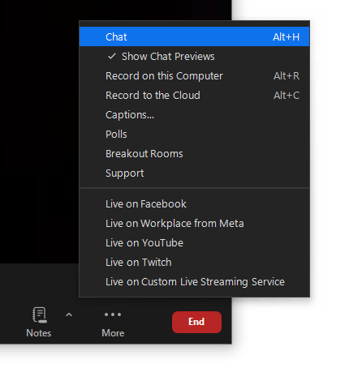
WEBINAR HOUSEKEEPING TIPS
Reminder: All attendees can see our team as hosts but we cannot see you.
To ask a question, please type these in the chat. We will have Q&A at the end of the webinar.
This webinar is being recorded and will be posted on the Traders Market website.

Slide 4
AGENDA
DATES/LOCATION
REGISTRATION & HOTEL INFORMATION
SCHEDULE HIGHLIGHTS
NETWORKING CENTRAL/FRIDAY STUDENT PROGRAM
BOOTH PACKAGE
SHIPPING DETAILS
KEY SERVICE CONTACTS
EXHIBITOR CHECKLIST
WIFI ONSITE / MOBILE APP
2025 BOOTH SALES

Slide 5
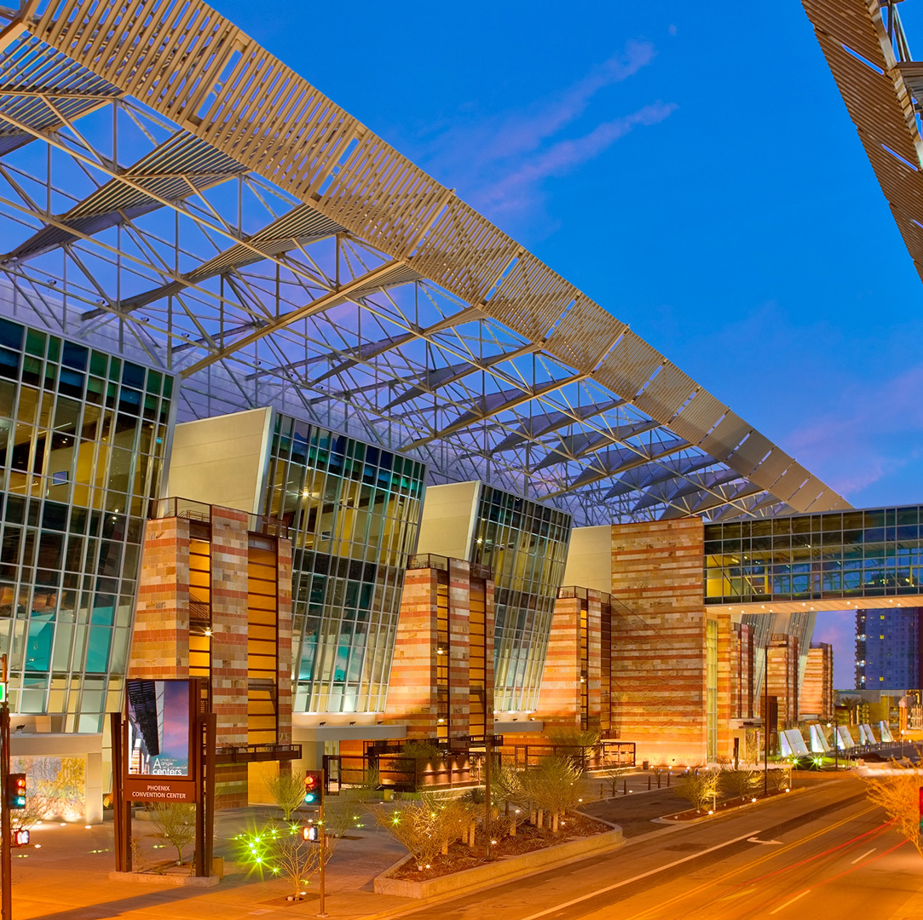
DATES/LOCATION
Wednesday, November 13 – Friday, November 15, 2024
Phoenix Convention Center, Phoenix, AZ
West Building
  Exhibits – West Halls 1-3

Slide 6
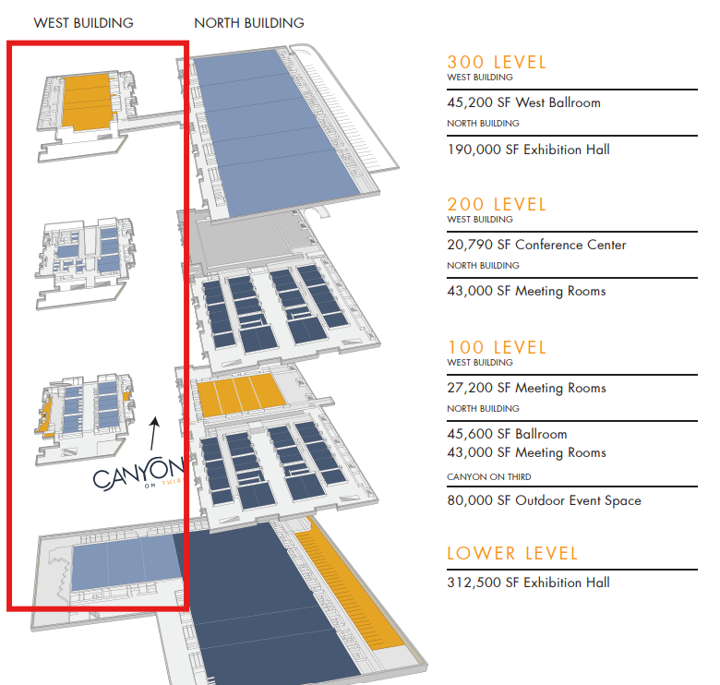
MAP OF PHOENIX CONVENTION CENTER
Sheraton Phoenix – 3 minute walk (walk straight down 3rd Street)
Hyatt Regency Phoenix – 1 minute walk (behind the convention center)
West Building – 3rd Street
  Lower Level – down 1 set of escalators
    Exhibit Halls 1-3
  Street/100 Level –
    Wednesday Block Party
      Hosted at Canyon on Third
    100 Level – Board/Committee/Ten Group Meetings
    Thursday Morning Education
      Peer2Peer Brewing West Foyer Space
      Stefanie Couch – 106ABC
  300 Level – up 2 sets of escalators
    Thursday Keynote Luncheon
      301 A-C

Slide 7
REGISTRATION DETAILS
Each 10’ x 10’ booth receives (1) complimentary registration badge
The primary contact for your company should have received step by step instructions how to register using your company’s complimentary code.
Please ensure your team is registered using the instructions provided to your primary contact via email.
  Each individual attending Traders Market MUST register (even the individual who receives the complimentary registration information)
We highly recommend registering ahead of time to prevent long wait times onsite
The registration desk will be located outside the Exhibit Hall – Lower Level Halls 1-3
If you have questions or need instructions re-sent, email registration@nawla.org

Slide 8
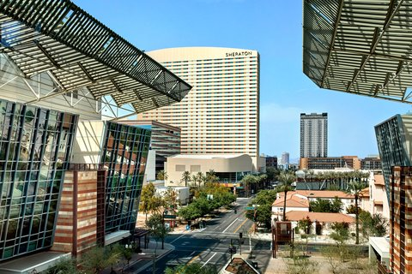
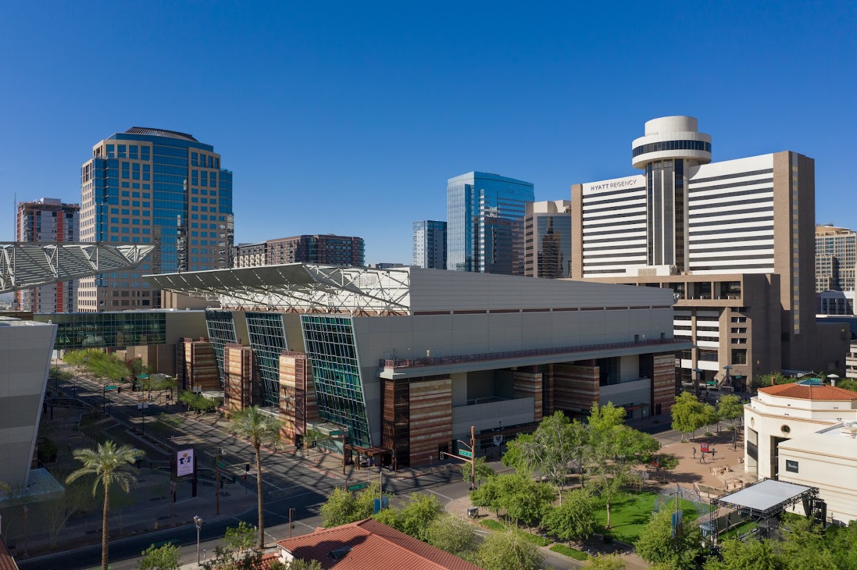
HOTEL INFORMATION
The official NAWLA housing deadline has passed.
Hotel booking options and rates are now subject to availability.
Both hotels are close to the convention center.

Slide 9
SCHEDULE HIGHLIGHTS
Wednesday, November 13
  Board/Committee/Ten Group Meetings
    See details directly provided to your group via email.
  Block Party Reception – Open to All Attendees & Exhibitors
    6:00pm-8:00pm
    Canyon on Third – outside convention center on 3rd street

Slide 10
SCHEDULE HIGHLIGHTS
Thursday, November 14
  7:00-5:30pm: Registration Open
  7:00-11:00am: Exhibitor Set-Up
  8:30-9:30am: Peer2Peer Brewing Solutions
  9:45-11:00am: Education Session
  11:15am-1:15pm: Keynote Luncheon
  1:30-6:00pm: Tradeshow Open
  5:00-6:00pm: Show Floor Reception
Friday, November 15
  8:00-11:30am: Registration Open
  8:00am-12:00pm: Tradeshow Open
  12:00pm-6:00pm: Exhibitor Move-Out

Slide 11
NETWORKING CENTRAL
Booth 523 – Center of Floor
Ten Groups in front right corner
  Learn more about our Ten Groups here!
2025 Booth Sales counter will be open
Mike Rayburn – Keynote Meet-and-Greet
  Thursday, November 14 starting at 1:30 PM
Hang out, network & relax!

Slide 12
FRIDAY STUDENT PROGRAM
Friday, November 15 - 9:00 - 11:30 AM
NAWLA will host college-aged students Friday morning on the Tradeshow floor to network with participating member companies. If you would like to sign-up your company to participate, please reach out to info@nawla.org.

Slide 13
EXHIBITOR SERVICE KIT
The Exhibitor Service Kit is LIVE
  You can access the Exhibitor Services Kit by clicking HERE.
New Users
  If you have not been on the Freeman website before, you will need to create an account with a User ID and Password.
Returning Users
  If you have already completed this step and you are not able to log in, please contact Freeman at 888.508.5054 or ExhibitorSupport@freemanco.com.

Slide 14
BOOTH PACKAGE DETAILS
Each 10x10 booth will be set with –
  8’ high black back drape
  3’ high black side drape on each side
  (1) 6’L x 30”H black draped table
  (2) chairs
  (1) wastebasket
The exhibit hall is NOT carpeted. All exhibitors must have flooring to cover the entirety of their booths.

Slide 15
SHIPPING DETAILS
Warehouse Shipping Address
  From October 14-November 5
    After the November 5 deadline, shipments received will incur an additional fee with Freeman
  Exhibiting Company Name / Booth Number
  North American Wholesale Lumber Association- Traders Market 2024
  C/O Crane / Freeman
  2800 S Gilbert Rd, Ste 103
  Chandler, AZ 85286
  USA
Show Site Shipping Address
  November 12-Show time
  Exhibiting Company Name / Booth Number
  North American Wholesale Lumber Association- Traders Market 2024
  Phoenix Convention Center
  C/O Freeman
  100 N 3rd St
  Phoenix, AZ 85004
  USA

Slide 16
RETURN SHIPPING DETAILS
On the last day of the show, Freeman will drop a form at each booth for return shipping.
No crates or boxes can be returned to your booth until the show closes at 12:00pm.
If you would prefer to ship smaller boxes via Fedex or UPS, you can do so by hand carrying these items to a local store near the convention center.
Reminder – any items left on the show floor will be assessed and charged material handling fees by Freeman to the exhibitor.

Slide 17
KEY SERVICE CONTACTS
Show Management
  Kendall Reynolds
  Kelsey Kwasniak
  Exhibits@nawla.org
General Service Contractor
  Freeman
  Phone: 888-508-5054
  Email: exhibitorsupport@freemanco.com
    Rigging
Audio/Visual
  Prestige AV
  Contact – Vlad Gamboa
  vgamboa@prestigeav.com
  513-641-1600
Catering
  Aventura Catering
  Contact – Sandy Brown
  Phone: (602)-534-8607
  Email: Brown-Sandy@aramark.com
Electrical
  Commonwealth Electric Company
  Contact – Cathee Cooper
  Phone: (602)-253-5881
  Email: ccooper@commonwealthelectric.com
Internet
  Smart City Networks
  Order online at: https://orders.smartcitynetworks.com
  Or call at: (888)-446-6911

Slide 18
EXHIBITOR CHECK LIST
Registration
  Register your team
  Exhibitors are provided (1) complimentary badge per 10x10 booth.
Hotel Rooms
  Once you register your team, you’ll receive an email confirmation with our hotel links to book your rooms.
  Hotel rooms are currently only open based on hotel availability if you contact the hotel directly.
  Booth Orders
    Reminder – your booth comes with pipe and drape, 1 6’ table, 2 chairs and a wastebasket.
    Any additional furniture must be ordered through Freeman’s online site. This furniture will be placed in your booth when you arrive for setup by Tuesday, Nov. 12 at 7am.
    Reminder – flooring is required. You can order via Freeman’s online site or bring your own flooring.
Electrical for your Booth
  Form in the Freeman online site to place with Commonwealth Electric.
  Reminder – no power is included in your booth. Even if you just want a basic plug for your laptop, you must order electrical.
Shipping
  Don’t forget to ship the items you plan to display in your booth to Freeman’s Advanced Warehouse to arrive by November 5.
    Items shipped to the warehouse will be dropped in your booth by the time you arrive on Tuesday, Nov. 12.

Slide 19
WiFI & Mobile App
Wi-Fi will be available throughout the convention center.
  Network Name: NAWLATM
  Password: tradersmarket24
Download the mobile app to your device by searching ‘NAWLA’ in your phone’s app store.
  The Mobile App will have the most up-to-date schedule, exhibit hall floorplan and more!
  Already have the mobile app? Access the NAWLA year-round app as well as the 2024 Traders Market app in the “Events” portion of the app

Slide 20
2025 Booth Sales
Remote Space Selection was held on 10/22 & 10/23 for current exhibitors that completed a 2025 contract.
  Booth confirmations and invoices will be sent in early 2025
Space can still be secured onsite at Networking Central, Booth 523
  Complete the 2025 Booth Contract to secure your space.
2025 Show Dates
  November 5-7, 2025
  Kansas City Convention Center – Kansas City, MO

Slide 21
Questions?

Slide 22
CONTACT US:
Kelsey Kwasniak
  Exhibits and Sponsorship Manager
    P: (312)-673-5387
    E: kkwasniak@nawla.org
Kendall Reynolds
  Exhibits and Sponsorship Coordinator
    P: (312)-673-4723
    E: exhibits@nawla.org and kreynolds@nawla.org

