Slide 2
NAWLA Traders Market
Webinar #1 – Exhibitor Service Kit Launch and Key Details
Hosted By: Kelsey Kwasniak and Kendall Reynolds

Slide 3
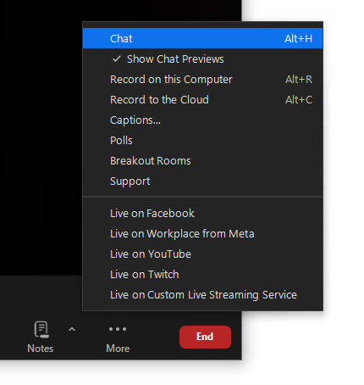
Webinar Housekeeping Tips
Reminder: all attendees can see our team as panelists, but we cannot see you
To ask a question, please type these in the “chat” or “Q&A” function within your Zoom toolbar. We will answer questions at the end of the webinar
This webinar is being recorded and will be posted to the Exhibitor Resource Page on NAWLA’s Traders Market website.

Slide 4
Agenda
Key Show Details
  Dates/Location
  Show Hours
  Key Contacts
  Registration
  Housing
  Security Tip
Booth Package
Shipping Details
Important Deadlines
Accessing Exhibitor Services Kit
Networking Opportunities
Frequently Asked Questions
Reviewing Exhibitor Checklist

Slide 5
Key Show Details
Wednesday, November 4th – Friday, November 6th
Anaheim Convention Center
  800 W. Katella Ave, Anaheim, CA 92802
  Event Space – ACC North Building Exhibit Hall (next to Hilton Anaheim)
Schedule of Events: Click HERE
General Service Contractor – Freeman
  Phone: 888-508-5054
  Email: exhibitorsupport@freemanco.com

Slide 6
Show Schedule
Exhibitor Move In
  Wednesday, November 4
    8:00AM – 5:00PM
  Thursday, November 5
    8:00AM – 11:00AM
Exhibit Hall Hours
  Thursday, November 5
    11:00AM – 5:00PM
  Friday, November 6
    8:00AM – 11:00AM
Exhibitor Move Out
  Friday, November 6
    11:00AM – 6:00PM
All exhibitors must be moved out no later than 6:00 PM on Friday, November 6th

Slide 7
Key Service Contacts
Show Management
  Kendall Reynolds
  Kelsey Kwasniak
  exhibits@nawla.org
General Service Contractor
  Freeman
  Phone: 888-508-5054
  Email: exhibitorsupport@freeman.co
Audio/Visual
  Encore
  Phone: 818-521-9867
  Email: acc@encoreglobal.com
Catering
  Aramark
  Email: ACC-Catering@aramark.com
Electrical
  Edlen
  Email: ExhibitorServices-Anaheim@edlen.com
Internet
  Smart City Networks
  Phone: 714-765-8600

Slide 8
Registration Information
One (1) complimentary registration per 10x10
All booth personnel must register through separate link
  Directions sent to main exhibit contact
Exhibitor registration portal here
  Need vendor code to access complimentary allotment
Contact exhibits@nawla.org for your code and allotment
Contact registration@nawla.org with any registration questions

Slide 9
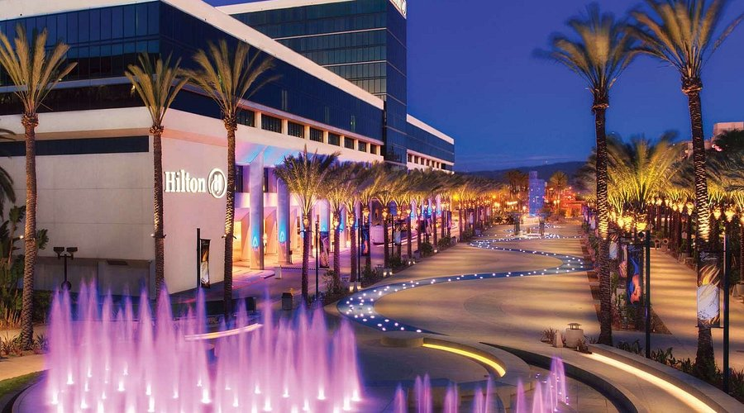
Housing & Travel Information
Hilton Anaheim
  777 W Convention Way, Anaheim, CA 92802
  $289/night + tax
  Hilton has a pathway direct to the Convention Center

Slide 10
Housing & Travel Information (cont.)
Link to book your hotel available in registration confirmation email
Fly into John Wayne Airport (SNA)
Deadline to secure NAWLA group rate is Monday, October 12 for the Hilton Anaheim
Hilton Anaheim Cancellation Policy: Hotel requires all reservations be guaranteed with a deposit equal to one night's room and tax. Should a guest cancel a reservation, the hotel shall refund the deposit, provided notice of cancellation is given 48 hours prior to arrival.

Slide 11
Security Tips
Take the follow precautions:
  Obtain insurance
  Don’t mark contents on the crates
  Do not store products in “EMPTY CARTONS”
  Ship products in locked cages/trunks
  Make a list of all products shipped
  Mount/attach products to display when possible
  Secure staff’s personal property
  Stay with your products on closing day until packed and marked for shipment
  Inform booth members of rules regarding removal of merchandise
  Do not sell, give away, or trade merchandise
  Don’t wait until end of show to report damage or theft
    Contact security and/or show management immediately

Slide 12
Booth Package Details
Each 10x10 booth will be set with –
  8’ high black back drape
  3’ high black side drape on each side
  (1) 6’L x 30”H black draped table
  (2) chairs
  (1) wastebasket
Exhibitors are not required to purchase flooring in 2026 based on existing carpet in the facility. Carpet can still be purchased at an additional cost to define your exhibit space

Slide 13
Shipping Details
Warehouse Shipping Address
  October 5 – October 28
  Exhibiting Company Name / Booth Number
  NAWLA Traders Market 2026
  C/O Freeman
  3456 E Miraloma Ave
  Anaheim, CA 92806
  USA
Show Site Shipping Address
  November 4 – Show time
  Exhibiting Company Name / Booth Number
  NAWLA Traders Market 2026
  Anaheim Convention Center
  C/O Freeman
  1850 West St
  Anaheim, CA 92802
  USA

Slide 14
Important Deadlines
Update Company Description – August 21
Advance Shipping
  Receiving begins October 5
  Receiving ends October 28
Freeman Discount Deadline – October 7
Catering Order Form Due – October 7
Electrical Order Form Due – October 14
AV Order Form Due – October 14
Internet Order Form Due – October 21
Lead Retrieval Order Form Due – October 21
Direct Shipping
  Receiving begins November 4

Slide 15
Company Listing
Your company listing will be featured in our mobile app and online floor plan.
Your company’s primary contact should have received an email with access to the Exhibitor Directory, where you can update your company description, product category, company logo and more.
If you have not received this email, please contact us and we’ll be happy to resend it.
Please note: All exhibitors MUST submit a description as we do not save company descriptions on file.
If a company description is not submitted, only your company information (name and booth number) will be included.
Please submit via the link sent to your email no later than Friday, August 21st to ensure your listing is included.

Slide 16
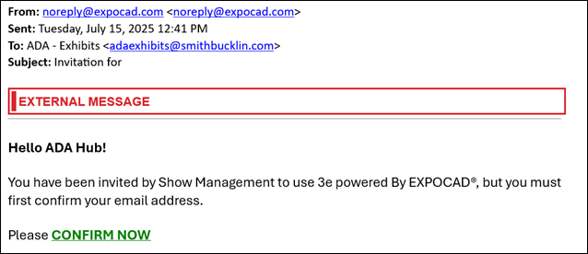
Company Listing – Email Example

Slide 17
Accessing the Exhibitor Services Kit
Service Kit Link: https://store.freeman.com/event-homepage?tab=event&eventId=540353
All users will create a new account
Resource Video for new Freeman platform

Slide 18
Networking Opportunities
Welcome Party
  Wednesday, November 4 from 5:30-7:00PM
Exhibit Hall Floor Open
  Thursday, November 5 from 11:00AM-5:00PM
  Friday, November 6 from 8:00AM-11:00AM
Show Floor Reception
  Thursday, November 5 from 4:00PM-5:00PM

Slide 19
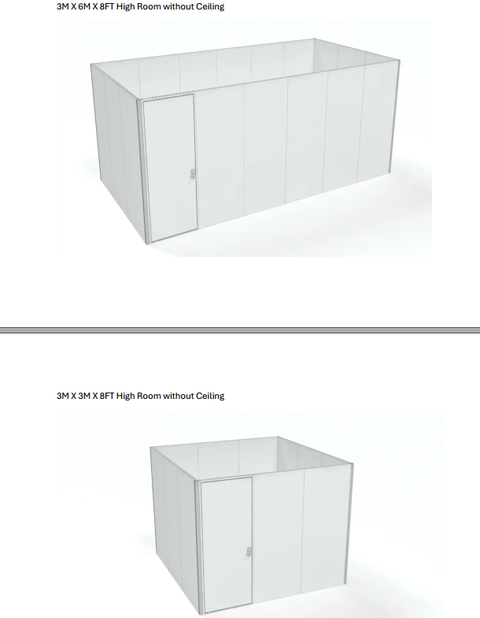
Need a Meeting Room?
Standard 3Mx6M Room
  Includes (1) 6’ draped table, (6) standard chairs, 24”x24” Room Sign with Sponsor Logo
    $750 per hour (9 total show hours) or 6,000 for 3 Days
New! 3Mx3M Room
  Includes (1) 4’ draped table, (3) standard chairs, 24”x24” Room Sign with Sponsor Logo
    $750 per hour or $4,000 for 3 Days

Slide 20
Frequently Asked Questions
Do I need to have carpet for my booth?
  Exhibitors are not required to purchase flooring in 2026 based on existing carpet in the facility. Carpet can still be purchased at an additional cost to define your exhibit space.
Freeman’s online site is charging me for furniture – I thought this was included?
  Yes – all exhibitors receive the following per 10x10 space. This means you do NOT need to place this order as it will be assumed and placed in your booth. If you would like additional furniture, you can do so by purchasing through Freeman’s online site or shipping your own furniture.
    Each 10’ x 10’ booth will be set with 8’ high black back drape, 3’ high black side drape, one 6’L x 30”H black draped table, two Limerick® chairs by Herman Miller, and one wastebasket.

Slide 21
Frequently Asked Questions
Am I required to sign up to exhibit for 2027?
  No – this is not required, however space does fill up quickly each year so we do recommend sending in your contract to secure your space. More details will be provided via email for space selection which will be held via Zoom in October.
Exhibitor Move In is on Wednesday and Thursday – do I have to move in on Wednesday?
  This will depend on the complexity/size of your space. We always recommend giving yourself more time by moving in on Wednesday given the hall opens on Thursday at 11:00AM. If you have a simple setup you can definitely arrive on Thursday morning to quickly setup.

Slide 22
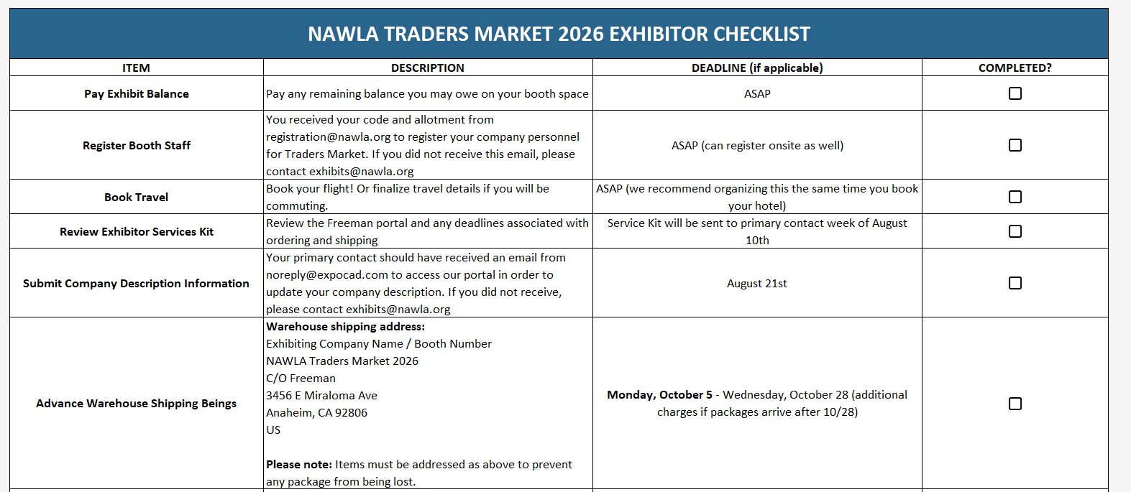
Exhibitor Checklist

Slide 23
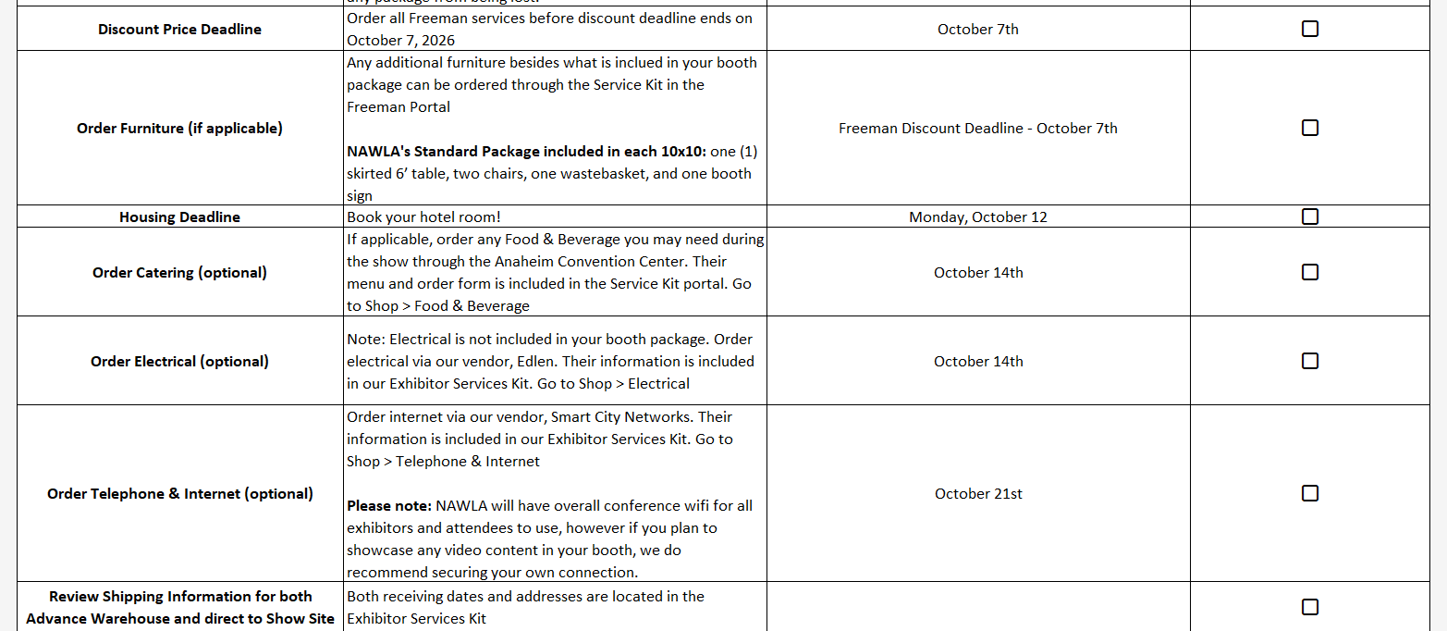
Exhibitor Checklist

Slide 24
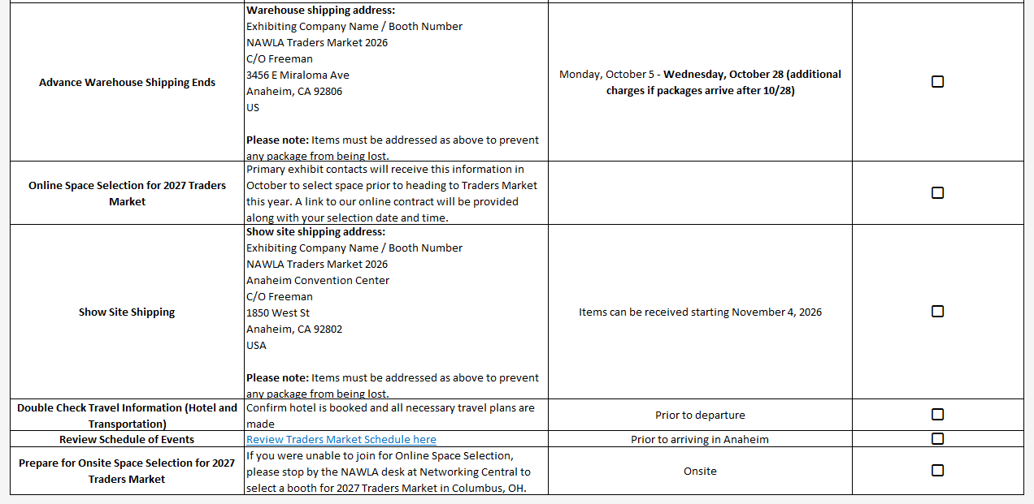
Exhibitor Checklist

Slide 25
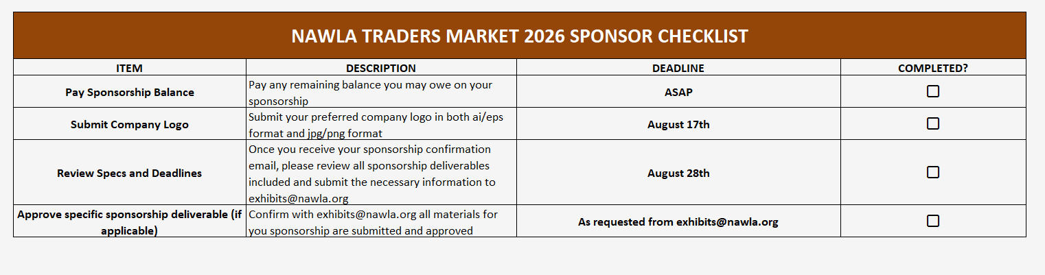
Sponsor Checklist

Slide 26
Questions?

Slide 27
Contact Us!
Kelsey Kwasniak
Kendall Reynolds
Exhibits & Sponsorship Manager
  P: (312)-673-5387
  E: kkwasniak@nawla.org, exhibits@nawla.org
Exhibits & Sponsorship Coordinator
  P: (312)-673-4723
  E: kreynolds@nawla.org, exhibits@nawla.org

